Slide 1

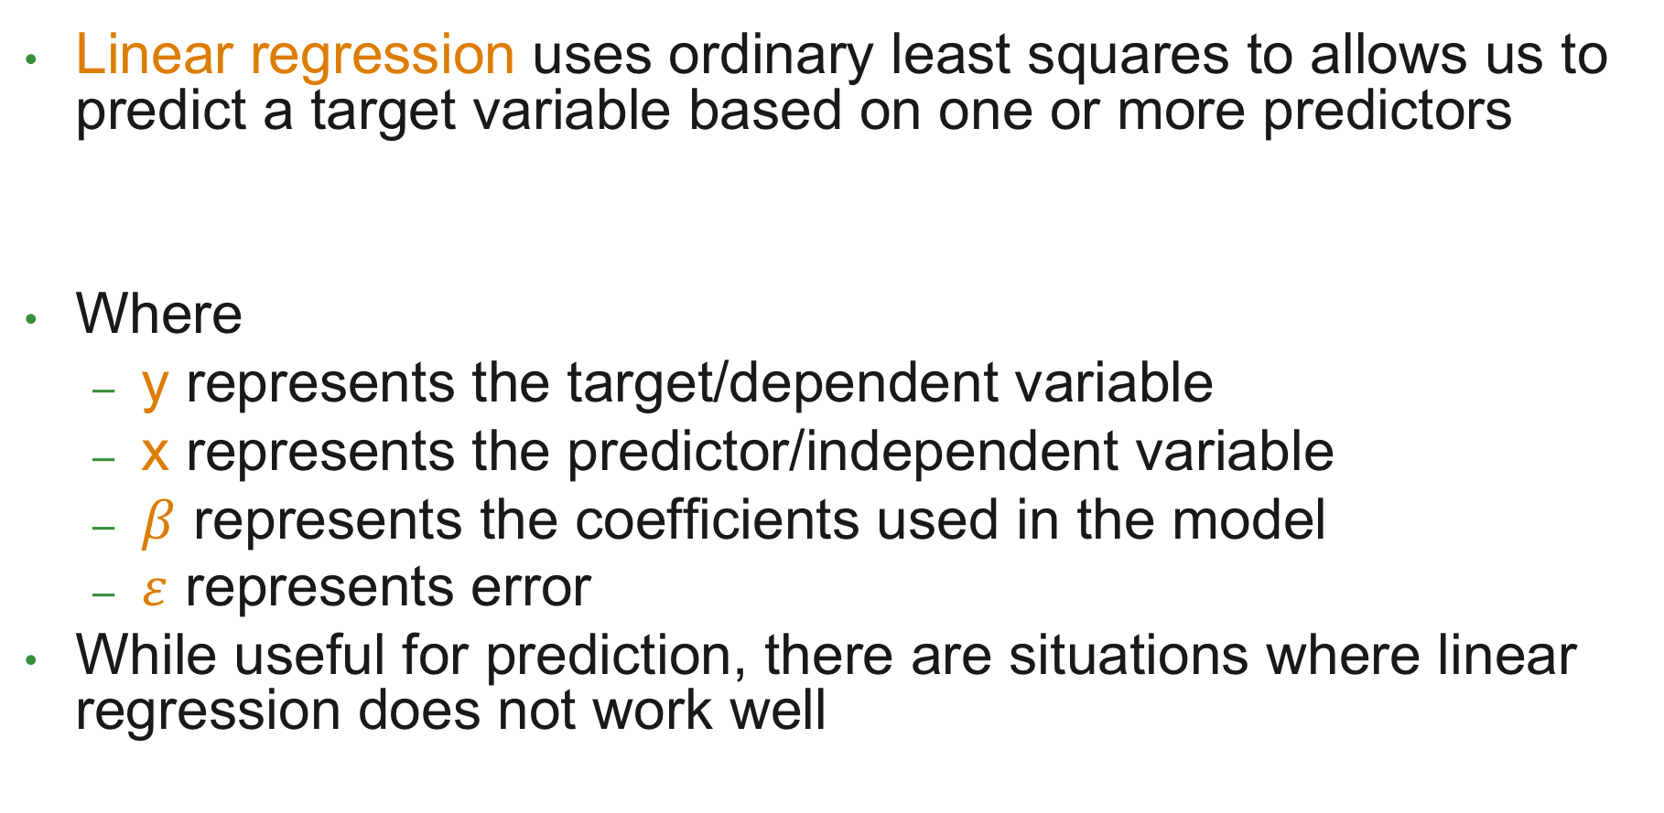
Revisiting Regression
Linear regression uses ordinary least squares to allows us to predict a target variable based on one or more predictors
Where
y represents the target/dependent variable
x represents the predictor/independent variable
$β$ represents the coefficients used in the model
$ε$ represents error
While useful for prediction, there are situations where linear regression does not work well
$$y=β_{0}+β_{1}x+ε$$

Slide 2
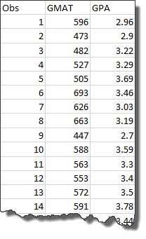
An Example
These data describe the GMAT score of a student, and the corresponding graduate GPA
We expect a relationship between these elements and linear regression confirms this conjecture, producing the following:
Based on this model we can predict the GPA associated with a given GMAT score:
$$GPA=1.185+0.004(GMAT)$$
$$GPA=1.185+0.004\left(600\right)=3.34$$

Slide 3
Visualize the Data

Slide 4
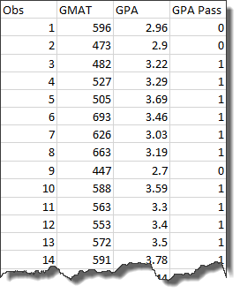
But Wait…
What if we didn’t have the GPA, just whether or not the student passed?
You can use regression to model this situation
We can still predict GPA based on GMAT, but we end up with a “probability”
$$GPA=−1.754+0.004(GMAT)$$
$$GPA=−1.754+0.004\left(600\right)=0.935$$
$$GPA=−1.754+0.004\left(200\right)=−0.858$$
$$GPA=−1.754+0.004\left(800\right)=1.832$$

Slide 5
Visualize the Data

Slide 6
Is Linear Regression the Best Choice?
There are two major issues when linear regression is used to model binary target variables
Non-Conforming Probabilities - Predicted probabilities can be >1 or <0 leading to model interpretation difficulties
Heteroskedasticity – The model is heteroskedastic by construction (the error terms depend on the value of X)

Slide 7
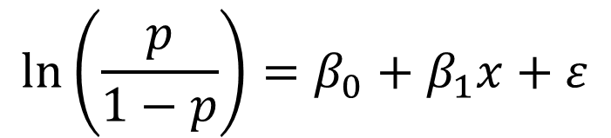
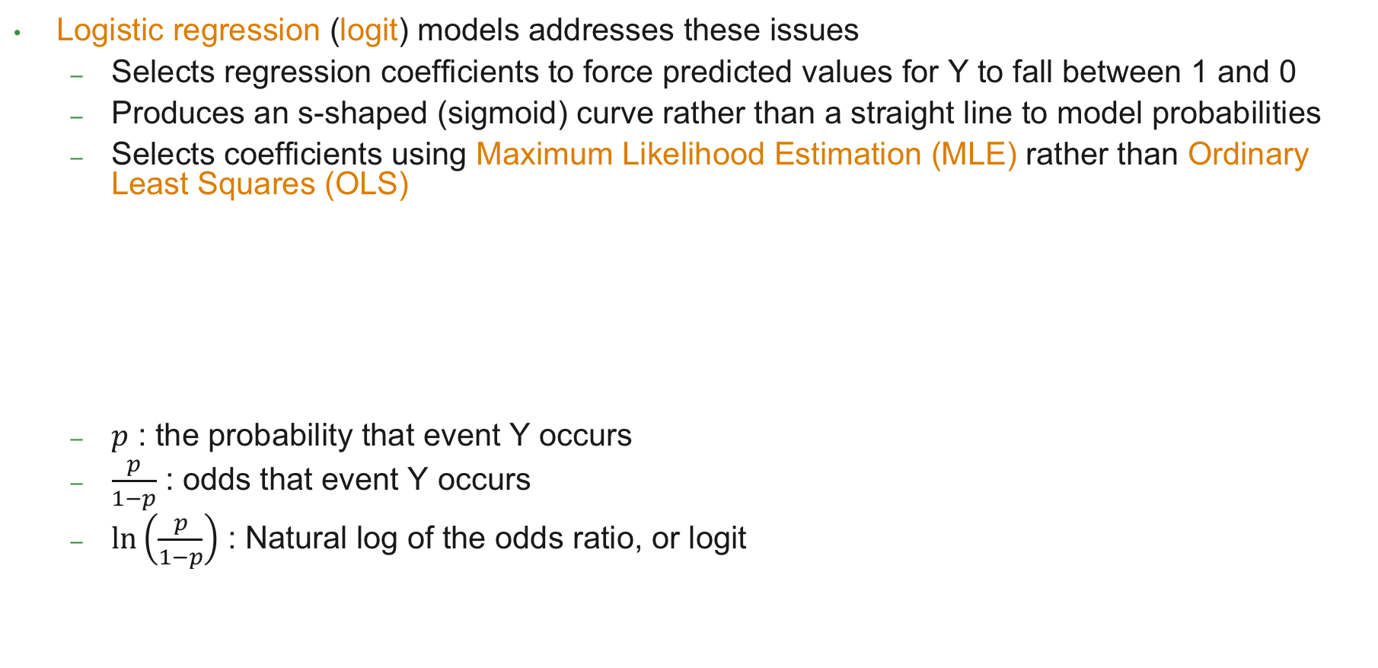
Logistic Regression
Logistic regression (logit) models addresses these issues
Selects regression coefficients to force predicted values for Y to fall between 1 and 0
Produces an s-shaped (sigmoid) curve rather than a straight line to model probabilities
Selects coefficients using Maximum Likelihood Estimation (MLE) rather than Ordinary Least Squares (OLS)
$p$ : the probability that event Y occurs
$\frac{p}{1−p}$ : odds that event Y occurs
$\ln\left(\frac{p}{1−p}\right)$ : Natural log of the odds ratio, or logit
$$\ln\left(\frac{p}{1−p}\right)=β_{0}+β_{1}x+ε$$

Slide 8
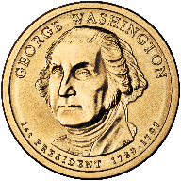
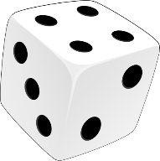
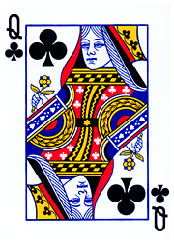

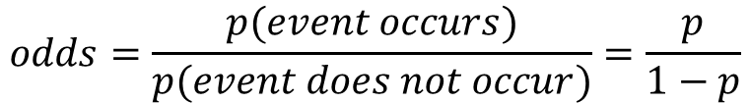


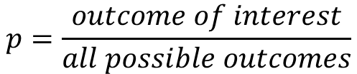



Probability vs Odds
$$p=\frac{outcome of interest}{all possible outcomes}$$
$$odds=\frac{p(event occurs)}{p(event does not occur)}=\frac{p}{1−p}$$
$$p\left(heads\right)=\frac{1}{2}=0.5$$
$$odds\left(heads\right)=\frac{0.5}{1−0.5}=1 or 1:1$$
$$p\left(1 or 6\right)=\frac{2}{6}=0.333$$
$$odds\left(1 or 6\right)=\frac{0.333}{1−0.333}=\frac{1}{2}=0.5 or 1:2$$
$$p\left(club\right)=\frac{13}{52}=0.25$$
$$odds\left(club\right)=\frac{0.25}{1−0.25}=\frac{1}{3}=0.333 or 1:3$$

Slide 9
Back to the Problem at Hand…
We need an S-shaped curve that approaches but never equals 0 or 1

Slide 10


Logit
When graphed, the logit (log odds) produces a curve which is similar to what we are seeking
$logit\left(p\right)=\ln\left(odds\right)$
$$=\ln\left(\frac{p}{1−p}\right)$$

Slide 11

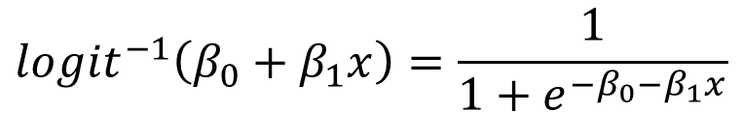
Inverse Logit
The logit function is close, but we need to flip it on its side
This can be accomplished by taking its inverse
$logit\left(p\right)=\ln\left(\frac{p}{1−p}\right)=β_{0}+β_{1}x$
$${logit}^{−1}\left(β_{0}+β_{1}x\right)=\frac{1}{1+e^{−β_{0}−β_{1}x}}$$
Estimated Probability of Event Y

Slide 12
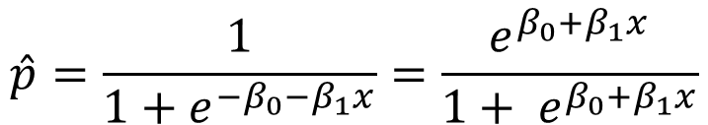
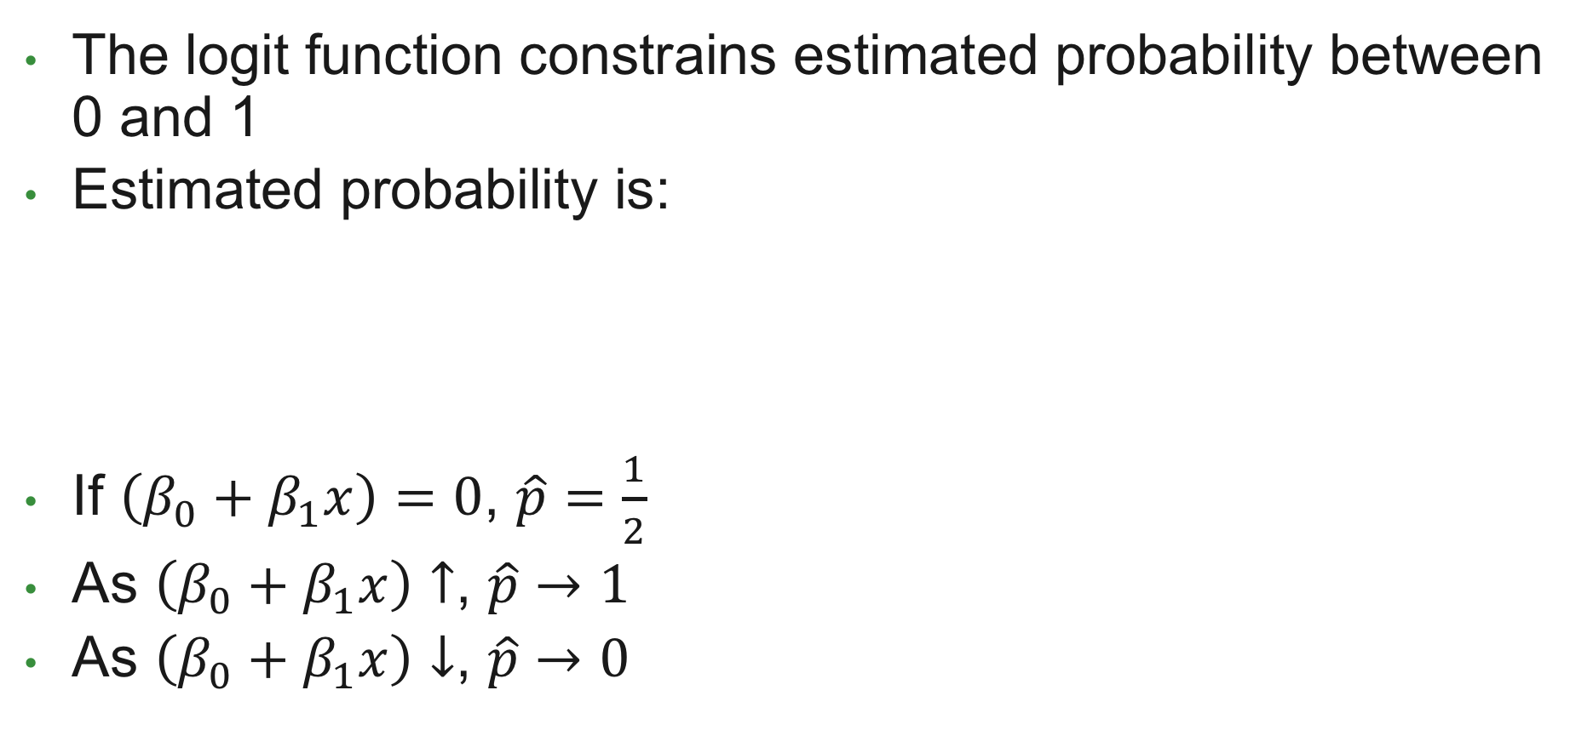
A Better Estimation of Probability
The logit function constrains estimated probability between 0 and 1
Estimated probability is:
If $\left(β_{0}+β_{1}x\right)=0$, $\hat{p}=\frac{1}{2}$
As $\left(β_{0}+β_{1}x\right)↑$, $\hat{p}→1$
As $\left(β_{0}+β_{1}x\right)↓$, $\hat{p}→0$
$$\hat{p}=\frac{1}{1+e^{−β_{0}−β_{1}x}}=\frac{e^{β_{0}+β_{1}x}}{1+ e^{β_{0}+β_{1}x}}$$

Slide 13
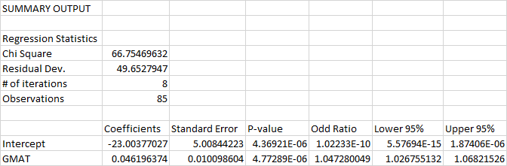
Back to our Example
If the CI contains 1, the variable has little to no effect

Slide 14
Visualizing the Predicted Probability

Slide 15

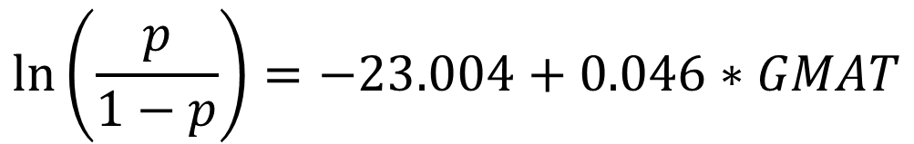
Back to our Example
$$\ln\left(\frac{p}{1−p}\right)=−23.004+0.046∗GMAT$$
What does this mean?
It is the rate of change in the log odds as GMAT changes

Slide 16
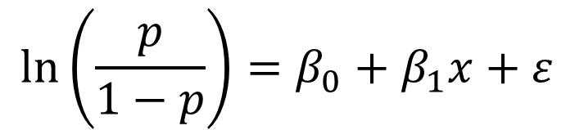
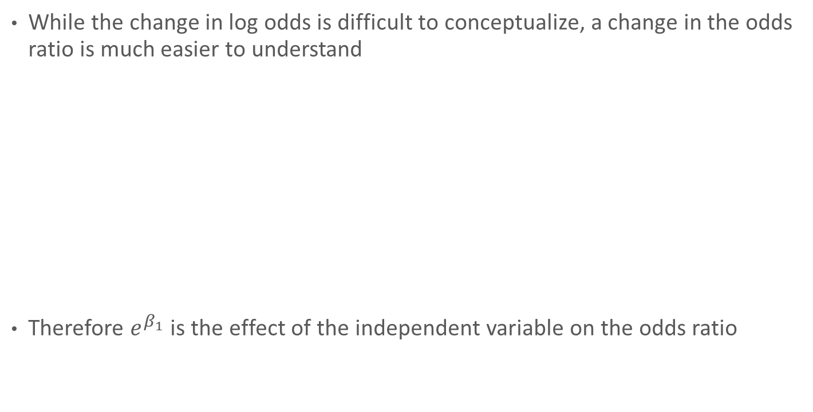
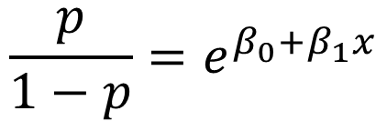
Interpreting Coefficients
While the change in log odds is difficult to conceptualize, a change in the odds ratio is much easier to understand
Therefore $e^{β_{1}}$ is the effect of the independent variable on the odds ratio
$$\ln\left(\frac{p}{1−p}\right)=β_{0}+β_{1}x+ε$$
$$\frac{p}{1−p}=e^{β_{0}+β_{1}x}$$

Slide 17
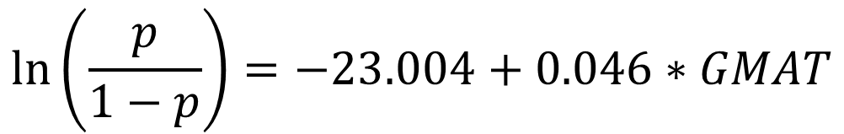

Interpreting Coefficients
The logistic regression equation is
Therefore the odds are
So a 1 unit increase in GMAT score increases the odds by a factor of
$$\ln\left(\frac{p}{1−p}\right)=−23.004+0.046∗GMAT$$
$$\frac{p}{1−p}= e^{−23.004+0.046∗GMAT}=e^{−23.004}∗e^{0.046∗GMAT}$$
$$e^{0.046}≈1.047$$
Does this look familiar?

Slide 18

Back to our Example
$$e^{0.046}≈1.047$$

Slide 19
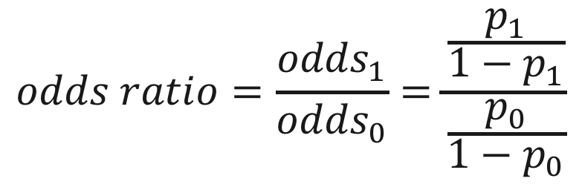
Odds Ratio
Each variable in a logistic regression model has an associated odds ratio
The odds ratio represents how the odds of the event occurring change with a 1 unit increase in that variable, all other things being equal
$$odds ratio=\frac{{odds}_{1}}{{odds}_{0}}=\frac{\frac{p_{1}}{1−p_{1}}}{\frac{p_{0}}{1−p_{0}}}$$

Slide 20
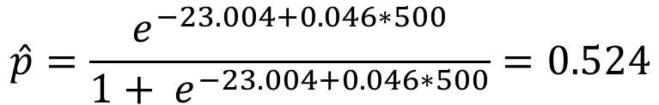
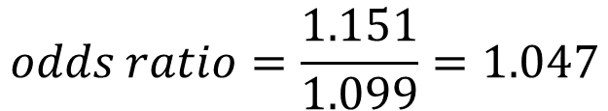
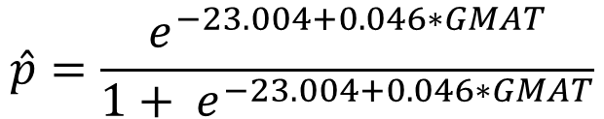
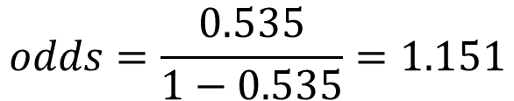
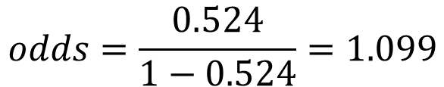
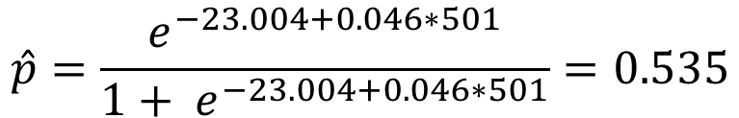
Odds Ratio
Remember, the odds ratio represents how the odds of the event occurring change with a 1 unit increase in that variable, all other things being equal
$$\hat{p}=\frac{e^{−23.004+0.046∗GMAT}}{1+ e^{−23.004+0.046∗GMAT}}$$
$$\hat{p}=\frac{e^{−23.004+0.046∗500}}{1+ e^{−23.004+0.046∗500}}=0.524$$
$$\hat{p}=\frac{e^{−23.004+0.046∗501}}{1+ e^{−23.004+0.046∗501}}=0.535$$
$$odds=\frac{0.524}{1−0.524}=1.099$$
$$odds=\frac{0.535}{1−0.535}=1.151$$
$$odds ratio=\frac{1.151}{1.099}=1.047$$

Slide 21
Some Potential Problems
Omitted Variables
Model leaves out one or more important causal factors
Biases the coefficients produced by the model
Irrelevant Variables
Inclusion of irrelevant variables can result in poor model fit
Pay attention to variable significance!
Improper Functional Form
The relationships between variables are not linear
Can result in biased coefficient estimates
Try different functional forms of the independent variables (log, squared terms, etc.)
Multicollinearity – highly correlated independent variables

